Slide 1
Sketching with Hardware
03: Soldering

Slide 2
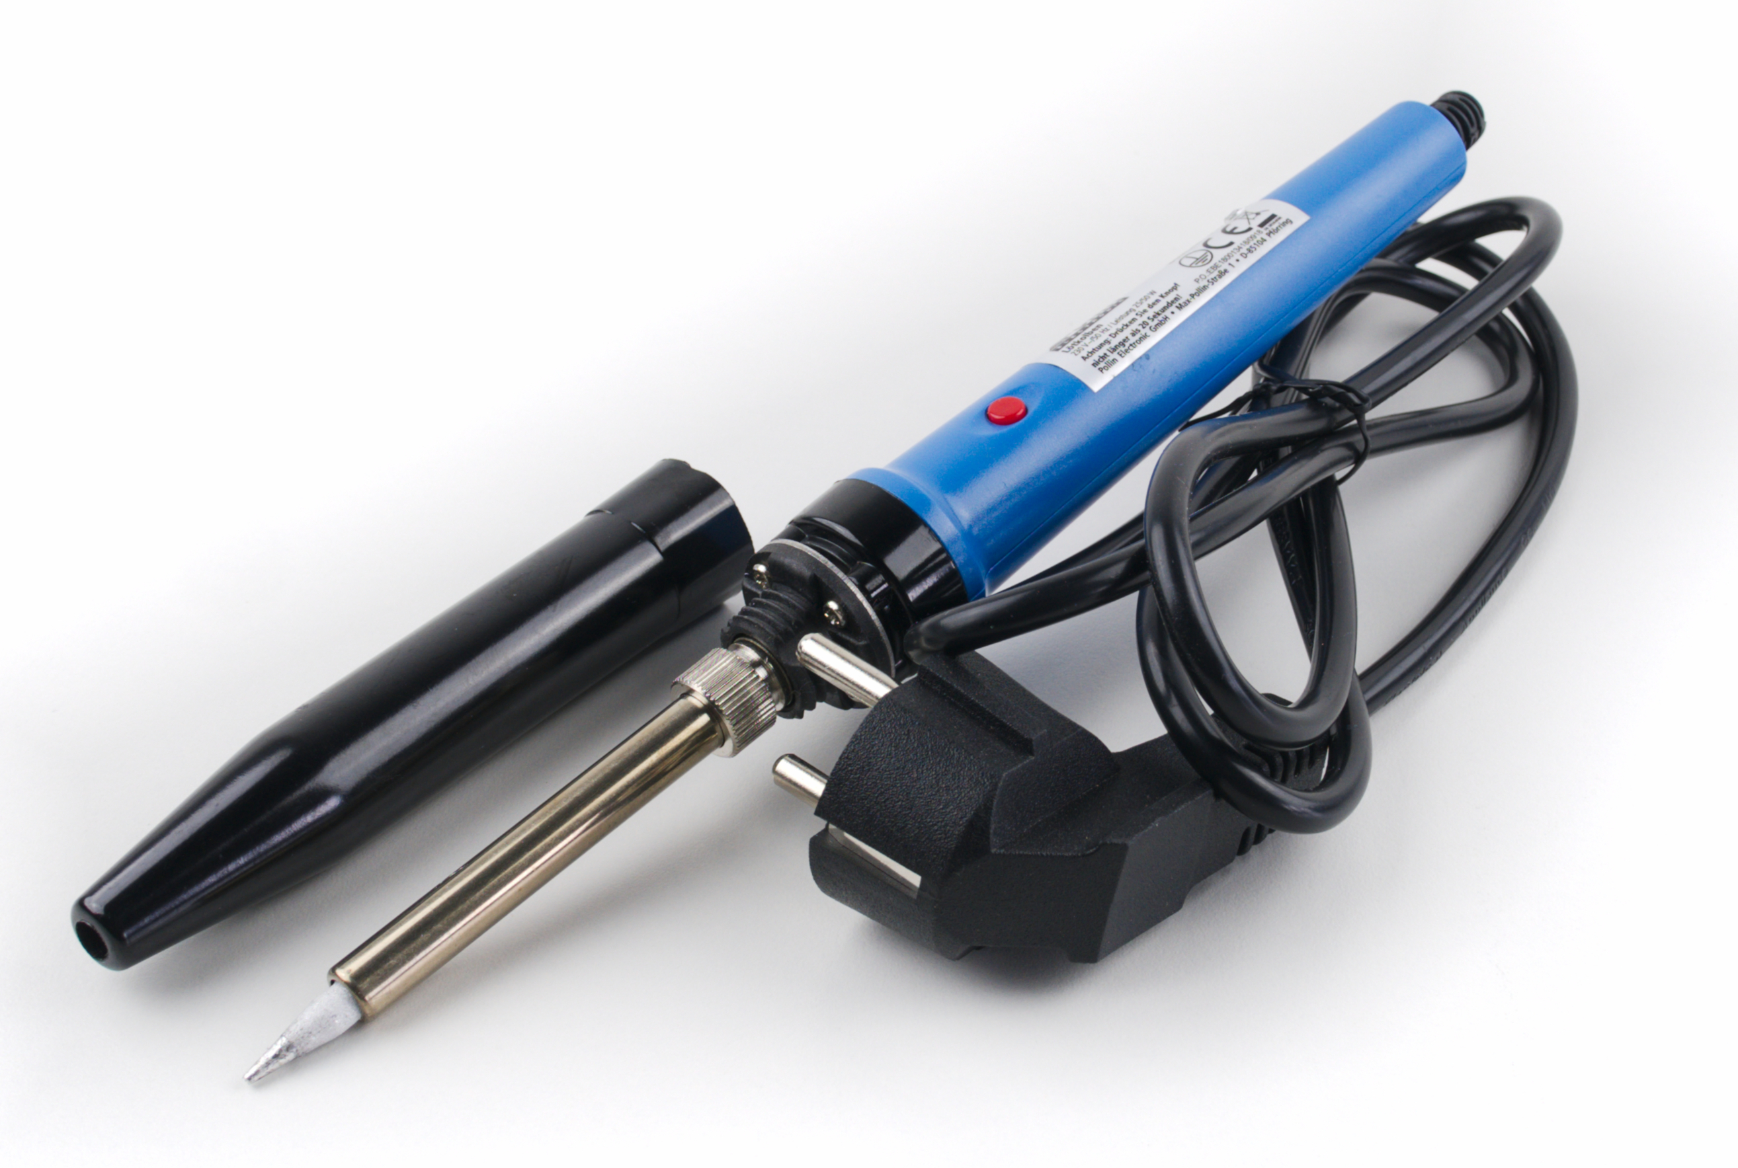
Soldering Iron

Slide 3
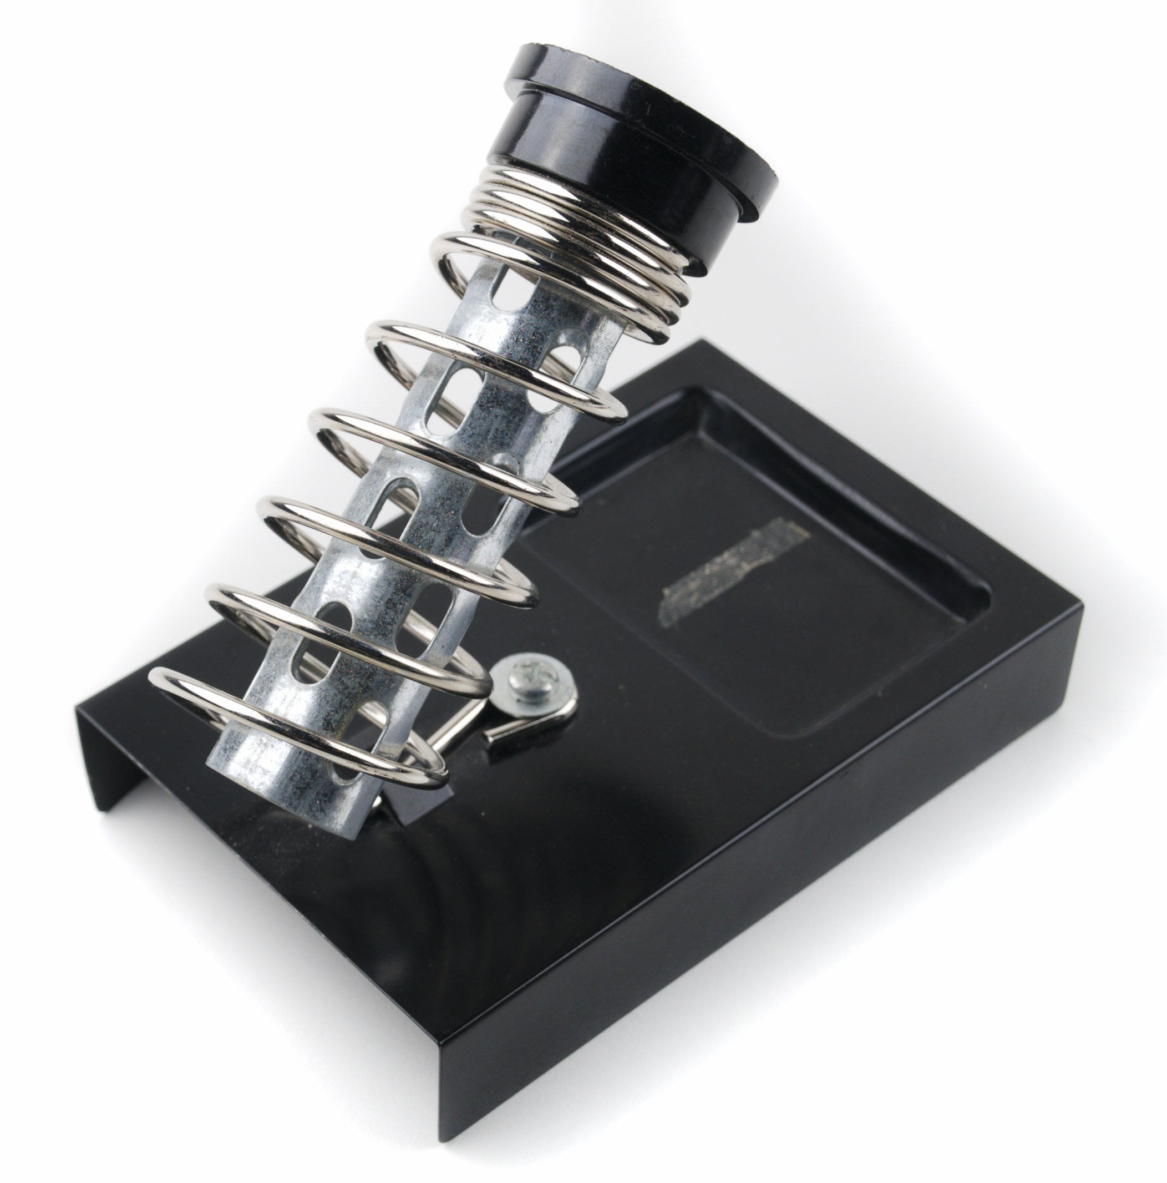
Soldering Iron Stand

Slide 4
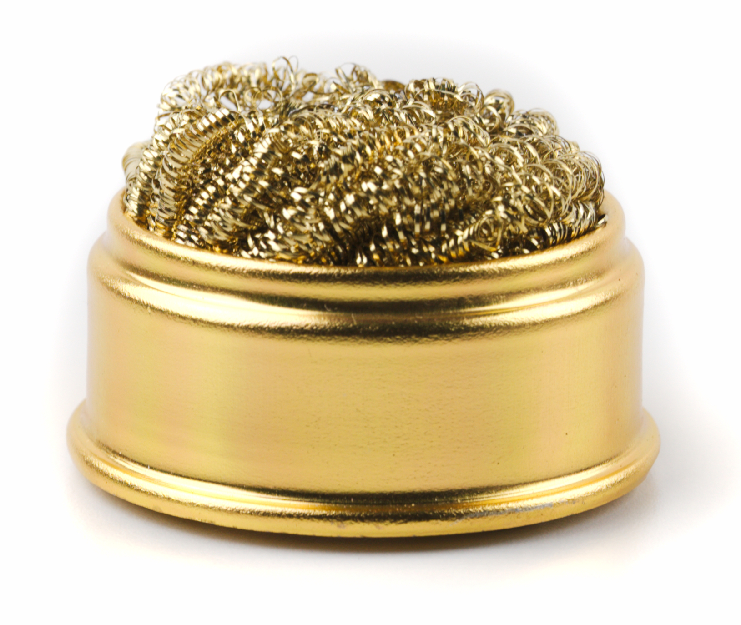
Soldering Tip Cleaner

Slide 5
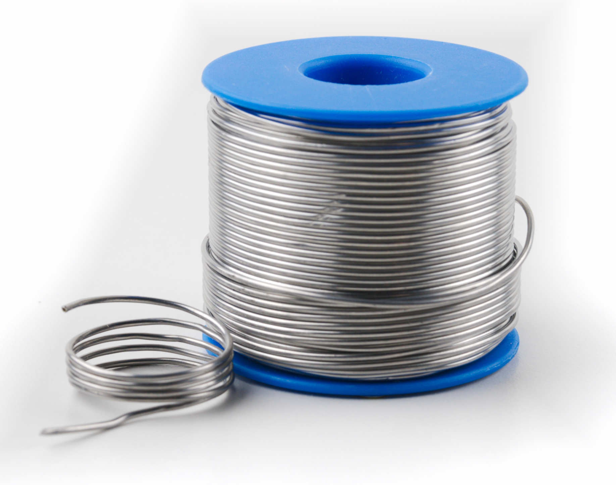
Solder

Slide 6
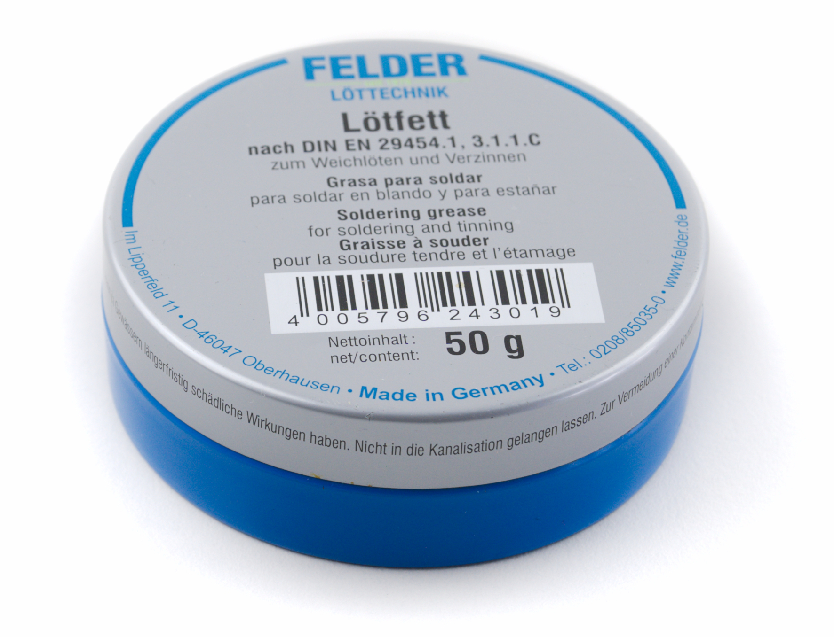
Solder Flux

Slide 7
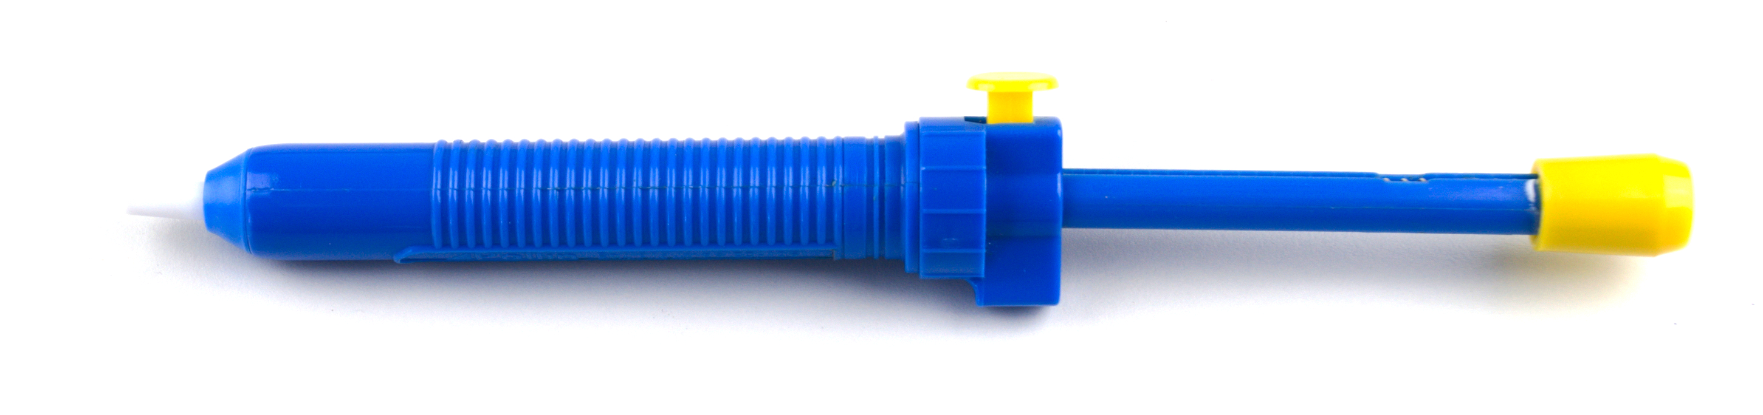
Desoldering Pump

Slide 8
Safety Instructions
The soldering iron gets hot (over 300 °C)
Do not touch metal parts
Use the soldering iron stand
Unplug if not needed anymore
Solder contains lead (which is poisonous)
Wash you hands after using it (and especially before eating)
Do not inhale the soldering smoke

Slide 9
Preparation
Make room on your table
Prepare your soldering tools:
Soldering iron + stand (do not plug it in yet)
Solder
Soldering tip cleaner
Working surface
Desoldering pump
Solder flux

Slide 10
Placeholder: Closeup soldering

Slide 11
Some tips
Bigger contact area → faster heat transfer
Many components are heat sensitive
→ Try to solder them quickly
Cover wire with solder beforehand (solder flux helps)
Clean the soldering iron before and after use

Slide 12
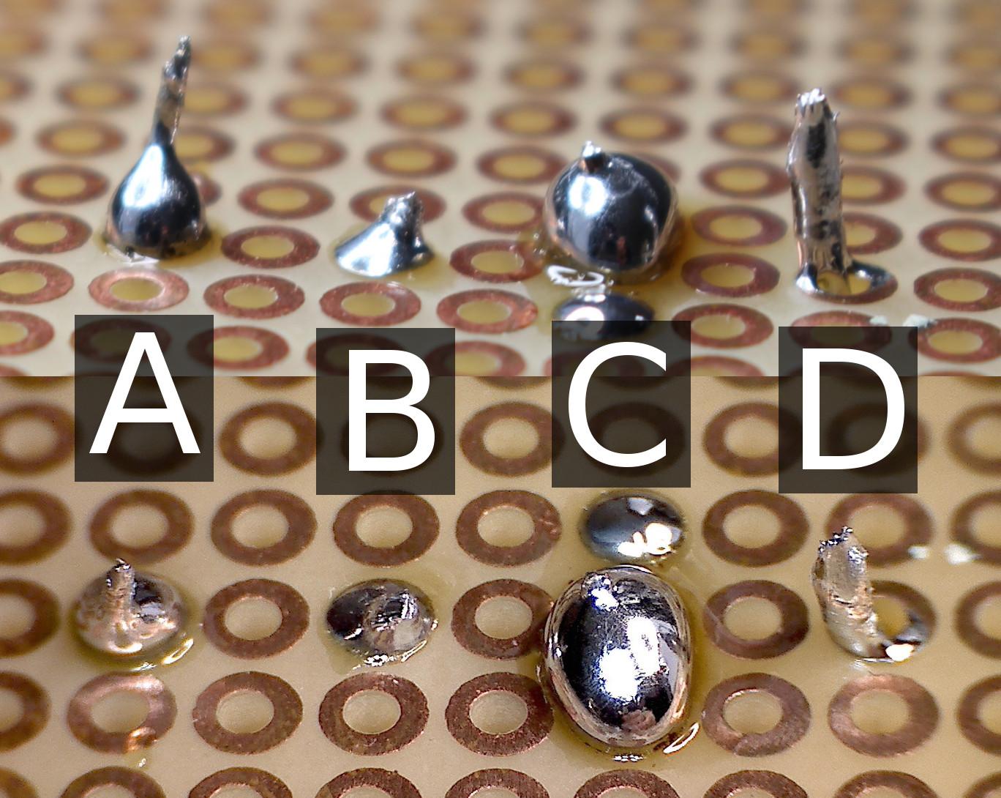
Good vs Bad Soldering...

Slide 13

Live Demo...
https://commons.wikimedia.org/wiki/File:USAF_EOD_explosion.jpg

Slide 14
Tutorial 02 - Soldering

Slide 15
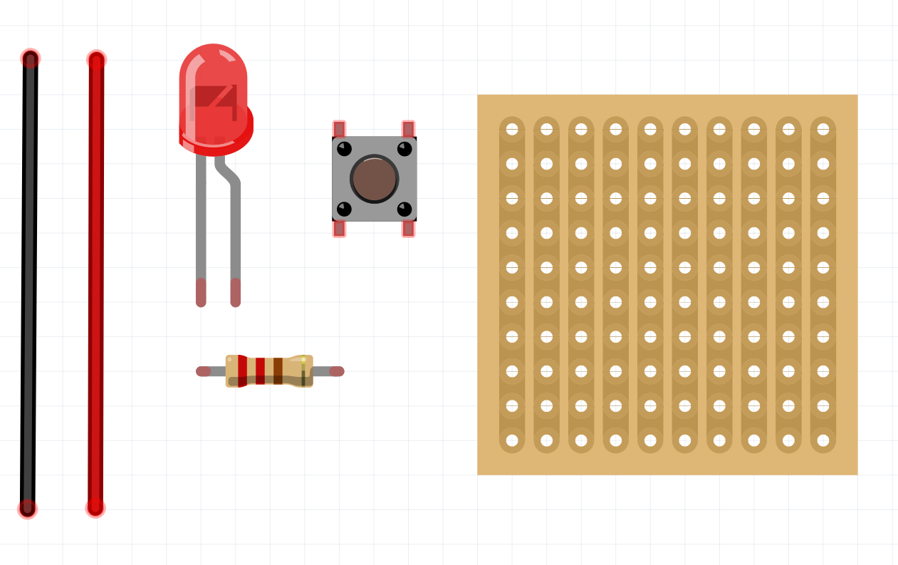
Exercise: Mini-Circuit
LED, button, resistor, wire, perfboard
Created with Fritzing

Slide 16
Approach
Think of a layout beforehand
Bend the component’s legs to fit into the board
Place components on the copperless side of the board
Solder components on the back side
Tip: Begin with resistor and wire as they are more resistant to heat
→ Heat can damage the LED or melt the plastic button

Slide 17
Testing the circuit
Continuity testing:
Is everything connected properly?
Are there any short circuits?
Plugging it in…
Red wire to 5V (+), Black wire to GND (-)
If it does not work: Troubleshooting
Correct polarity of the LED?
Correct resistor?
Is current flowing?
...

Slide 18
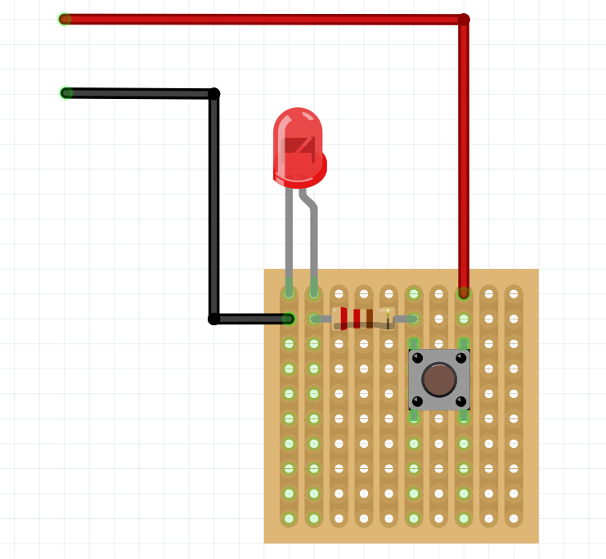
Solution
Created with Fritzing

